Slide 1


Git
What is git and why should we use it?

Slide 2
What is Git?
Git is a mature, actively maintained open source project originally developed in 2005 by Linus Torvalds, the famous creator of the Linux operating system kernel.
A short version of the explanation is, Git will keep track of all the changes of your project. It will show who did make a change, what is changed, and when it changed.
You can always go back to an earlier state of the code if you want to, you can share your code anytime and work with everybody and everywhere.

Slide 3

What is Git?
Git is your swiss knife and best friend.
An evil one. He can easily stab you in a back or shoot in your leg.
But you can easily reset that episode of your friendship to previous commit as nothing happened.
Or you can’t.
Just a joke ;)
or not

Slide 4
The Problem
Anyway, git is a powerful tool that can be used for basic manipulations and advance high precision code manipulation and integrations.
Even though someone is sceptical about the benefits of using git system for salesforce, it can be a saviour at least of our efficiency and mental health.
Without git we can come up to a situation where we hypothetically can have we “sources of truth” of our code. We can have production source code, sanbox1 source code, sandbox2 source code and few scratch orgs with new features and so on.

Slide 5
The Problem
We as a developers have following questions in this situation:
Where is the most up to date code that we can use as a base to develop new feature and deploy on production?
When we finish all our new feature from all the sandboxes, how we deploy them and don’t override our code?
What is the difference between all this sources?
If two sources have different source code, which should we use?
Why we even end up in such situation?

Slide 6
The Answer
None of this would bother us if we use git.
Having teams with clear git workflow will result cleare source code vision. We will easily determine what is current state, which features are in development, who is working on what.
Git may seem confusing at first, but it is a must have type of tool nowadays. As no successful project could exist without management, no good code base can exist without proper source control.

Slide 7
How Git works
Some of the basic operations in Git are:
Initialize
Add
Commit
Pull
Push
Some advanced Git operations are:
Branching
Merging
Rebasing

Slide 8
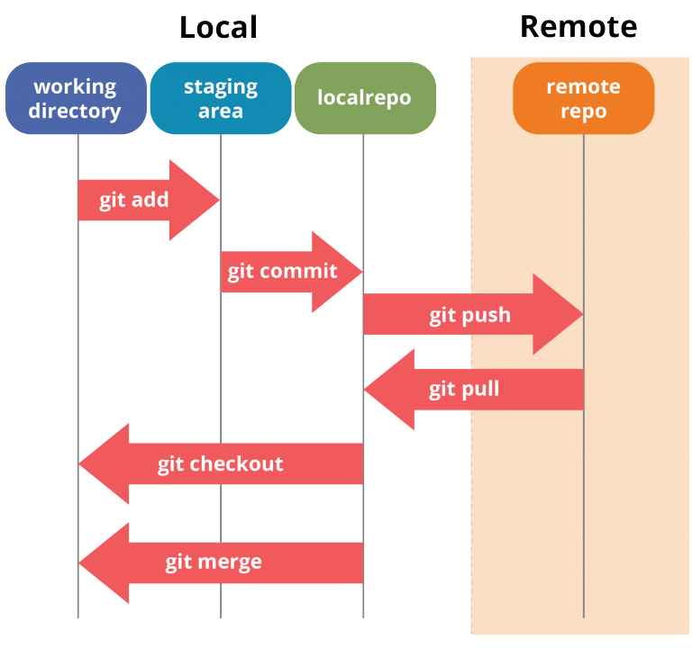
How Git works

Slide 9
Basic commands
git init - initialize repository
git add . - add everything to a staging area
git commit -m “commit message” - commit staging area content to a branch in a local repository
git remote add <remote repo name> <repo link> - add remote repository to “repository list”
git push <remote repository name> <branch name> - push changes of branch to remote repository
git pull <remote repository name> <branch name> - pull changes of branch from remote repository
git checkout -b <new branch name> - create new branch with provided name and checkout
git checkout <existing branch name> - checkout to existing branch

Slide 10
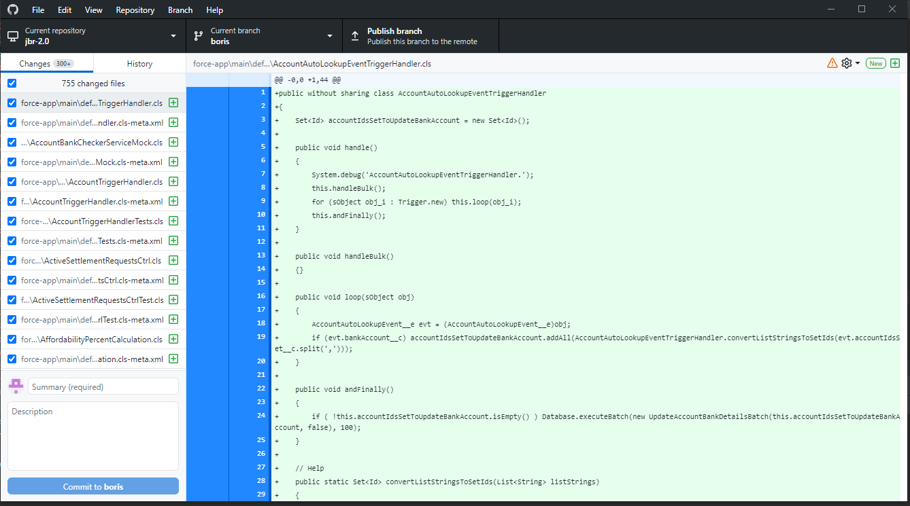
Git tools
Github Desktop Git UI

Slide 11
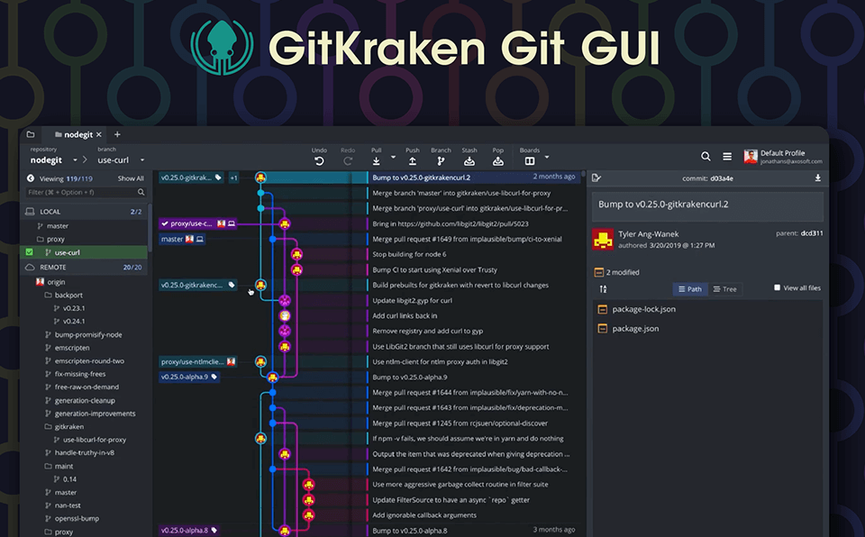
Git tools

